Slide 1
Category review: Chips
April 2026
Retail Analytics
Prepared by
Mukul Dimri
Brand note: If client logo is not required, use alternate title page layout right click slide thumbnail > Layout > Title

Slide 2
Notes:
To view Privacy video explaining how important data privacy is to Quantium, please click here: https://www.youtube.com/watch?v=Zq1QDAkoRzU
or here Q:\Company Reference\Brand & Design\Brand videos\Q Privacy.mp4
At Quantium, we believe that data is the behavioural footprint of humanity and that it has to be treated with the utmost care and responsibility.
Histories, attitudes, indeed lives are stored within it in ways that aren’t always apparent – and that’s what makes its potential so powerful.
To work with it responsibly, sensitively, we set ourselves the highest data privacy protection and governance standards.
We have spent 17 years perfecting privacy-by-design and secure-by-design principles. Central to this is not holding any personally identifiable information about people –
we neither receive it, and put the necessary protections in place to be unable to decipher it.
Every aspect of handling data is safeguarded: from its de-identification, to its encryption – data security is paramount and of the highest grade.
We pride ourselves on gaining the trust of iconic organisations around the world through years of securely working with their data,
and in turn the trust that builds with their stakeholders.

Slide 3
Executive summary
01
Task 1- Customer Purchasing Behaviour
Analysis of chip purchasing behaviour shows that young singles/couples and older families are the key drivers of sales within the category. These customer groups purchase chips more frequently and generate the highest revenue. Medium sized pack options (150g–175g) are the most popular products across most segments.
02
Task 2 - Trial Store Performance
Trial stores 77, 86 and 88 were compared against similar control stores using sales and customer metrics. The trial stores demonstrated stronger sales growth during the trial period, suggesting the new store layout positively influenced chip purchasing behaviour.

Slide 4
01
Category

Slide 5
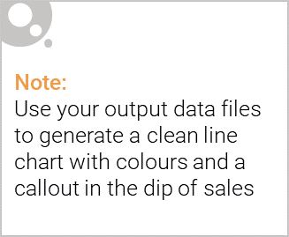
The chip category is driven by frequent shoppers, particularly young singles/couples and family households.
These customers purchase chips regularly as part of grocery shopping.
Sales are strongest for mid-sized packs (150g–175g) which appear to best match customer consumption preferences.
hip category is driven by frequent shoppers, particularly young singles/couples and family households.
These customers purchase chips regularly as part of grocery shopping.
Sales are strongest for mid-sized packs (150g–175g) which appear to best match customer consumption preferences.

Slide 6

Customer purchasing behaviour varies across affluence segments.
Mainstream and premium customers generate the highest sales value and tend to purchase larger pack sizes and well-known brands.
Budget customers still contribute to category sales but typically choose smaller or lower priced options.

Slide 7
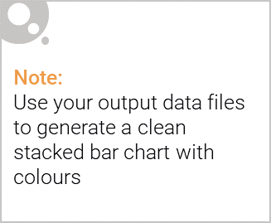
Editable (delete this)
The largest proportion of chip customers belong to young singles/couples and older families.
Across these groups, mainstream shoppers represent the largest share, followed by premium customers.
Understanding this distribution helps target marketing and promotional strategies more effectively.

Slide 8
02
Trial store performance

Slide 9
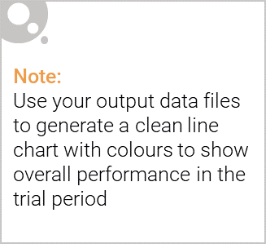
Trial stores 77, 86 and 88 were compared against control stores with similar historical sales patterns.
Metrics used for comparison included:
• total sales revenue • number of customers • transactions per customer
This method helps isolate the impact of the trial store layout.

Slide 10
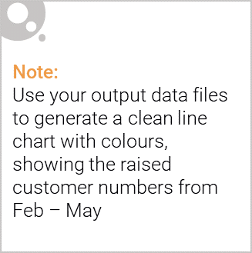
Sales performance during the trial period was higher in the trial stores compared with their control stores.
This uplift suggests the new store layout improved product visibility and encouraged additional chip purchases.
The trial results indicate the layout change was successful and could be expanded to additional stores.

